Slide 1
Minimize Test Power for Benchmark Circuit c6288 by Optimal Ordering of Test Vectors
By: Paul Wray

Slide 2
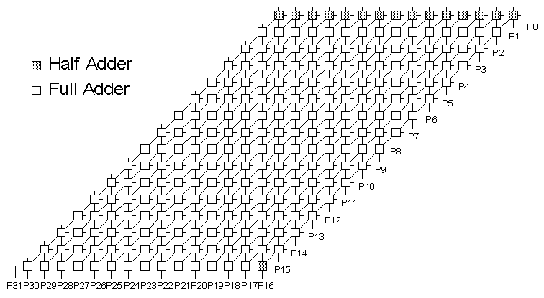
What is the c6288
16x16 Multiplier
32 inputs
32 outputs
2406 gates

Slide 3
Approach
Obtain Test Vectors using Matlab.
Using greedy Heuristics Approach, Find Optimal Ordering of Test Vectors.
Genetic Algorithm (GA) to find Optimal Ordering of Test Vectors.
Use Powersim to Obtain Power Reduction of the Optimal Ordered Test Vectors.

Slide 4
How to Obtain Test Vectors
According to the Heuristic Theory, The minimal number of test vectors for this circuit is 6 test vectors.
A Solution set of 6 test vectors has never been found to truly test the circuit.
Most engineers have came up with 12.
Using Integer Linear Programming, a solution set of 10 Test Vectors has been found.

Slide 5
10 Test Vectors
V1 1101-1011-0110-1101-1101-1111-1111-1111
V2 0110-1101-1011-0110-1111-1111-1111-1111
V3 0000-0000-0000-0000-0010-1111-1111-1111
V4 1011-0110-1101-1011-1101-1111-1111-1111
V5 1111-1111-1111-1111-1101-0101-0101-0101
V6 1111-1111-1111-1111-0110-1010-1010-1010
V7 0011-1111-1111-1101-1101-0101-0101-0101
V8 0011-1111-1111-1101-1010-1010-1010-1011
V9 1110-1101-1011-0110-0010-1111-1111-1111
V10 1101-1011-0110-1100-1010-1010-1010-1010
These 10 Vectors are currently the best possible solution set for problematic benchmark circuit c6288.
These Vectors were found by Dr. Vishwani Agrawal and Kalyana R. Kantipudi, (Auburn Univeristy).

Slide 6
Using Matlab
 | V1 | V2 | V3 | V4 | V5 | V6 | V7 | V8 | V9 | V10
V1 |  | 12 | 15 | 10 | 11 | 14 | 12 | 14 | 14 | 10
V2 | 12 |  | 13 | 12 | 13 | 14 | 14 | 14 | 4 | 18
V3 | 15 | 13 |  | 15 | 26 | 23 | 23 | 19 | 11 | 17
V4 | 10 | 12 | 15 |  | 11 | 14 | 12 | 14 | 14 | 20
V5 | 11 | 13 | 26 | 11 |  | 15 | 3 | 17 | 15 | 21
V6 | 14 | 14 | 23 | 14 | 15 |  | 18 | 6 | 12 | 8
V7 | 12 | 14 | 23 | 12 | 3 | 18 |  | 14 | 18 | 22
V8 | 14 | 14 | 19 | 14 | 17 | 6 | 14 |  | 14 | 8
V9 | 14 | 4 | 11 | 14 | 15 | 12 | 18 | 14 |  | 16
V10 | 10 | 18 | 17 | 20 | 21 | 8 | 22 | 8 | 16
Inset test vectors V1-V10 into matlab to obtain distances between each vector.
The solution displayed to the left shows the distance (# of Hamming Transitions) between each Vector Set.

Slide 7
Example of Optimal Vector Ordering
00011
00000
11111
00111
c6288
9 Transitions
Rearranged vector set
00000
00011
00111
11111
c6288
5 Transitions

Slide 8
Using TSP or Genetic Algorithm to Solve Ordering Issues
V1
V2
4
V3
3
3
2
3
2
1
1
2
V4
V5

Slide 9
TSP Results (Given Path)
Using the original given test vector path
V1 > V2 > V3 > V4 > V5 > V6 > V7 > V8 > V9 >V10
This gives a total of 128 Hamming Transitions

Slide 10
TSP Results (Optimal Path)
V3 > V9 > V2 > V5 > V7 > V4 > V1 > V10 > V8 > V6
Optimal Path Gives a Hamming Transition Total of 77
As of now, this is the best path.

Slide 11
Greedy Heuristic
V3
V1
V2
V4
V5
V6
V7
V8
V9
V10
V1
V2
V4
V5
V6
V7
V8
V10
V1
V4
V5
V6
V7
V8
V10

Slide 12
TSP Results (Greedy Path)
Once you get to V2, you run into a problem that there are the same about of transitions from V2 > V4 as is from V2 > V1 so try both ways.
V3 > V9 > V2 > V4 > V1 > V10 > V6 > V8 > V7 > V5
This path produces 78 Hamming Transitions, which was obtained using the Greedy Heuristic Approach.
V3 > V9 > V2 > V1 > V4 > V5 > V7 > V8 > V6 > V10
This path provides 79 Hamming Transitions.

Slide 13
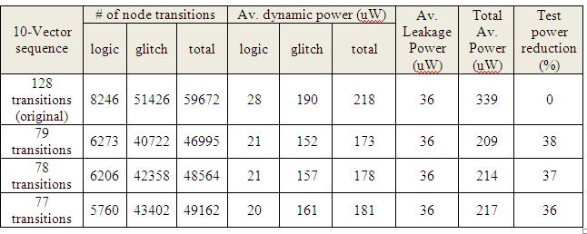
Results from Powersim
Parameters:
90nm Technology Rise Time = 2nS
Supply Voltage 1.5V Vector Period = 100nS

Slide 14
References
[1] J. D. Alexander, "Simulation Based Power Estimation for Digital CMOS Technologies," Master's Thesis, Department of ECE, Auburn University, December 2008.
[2] K. R. Kantipudi and V. D. Agrawal (2007), “A Reduced Complexity Algorithm for Minimizing N-Detect Tests," Proc. 20th International Conf. VLSI Design, Jan. , pp. 492-497.
[3]http://www.eecs.umich.edu/~jhayes/iscas.restore/c6288.html
[4]http://www.eng.auburn.edu/~vagrawal/COURSE/E6 270_Spr09/course.html

Slide 15
Acknowledgements
A Special Thanks to these 3 Guys
Manish Kulkarni – Support source for Powersim, Manish provided in depth help with powersim and the testing of these vector sets.
Nitin Yogi – Provided the 77 transition set solution and research on TSP(GA).
Dr. Vishwani Agrawal – Gave an interesting topic of discussion as well as the 10 test vector set. Instilled direction and support into the project.

